Slide 1
Software Engineering I
Dr. Elham Mahmoudzadeh
Isfahan University of Technology
mahmoudzadeh@iut.ac.ir
2024

Slide 2
Chapter 6 Behavioral modeling(I)

Slide 3
Steps(I)
Preparing proposal
Requirements determination
User story
Abstract Business Process Modelling
Analysis
Functional Modelling
Structural Modelling
Behavioral Modelling

Slide 4
Steps(II)
Design
Optimization
Database Management
User Interface
Physical Architecture

Slide 5
Behavioral model
Describe the internal dynamic aspects of an information system that supports the business processes in an organization.
During analysis, behavioral models describe what the internal logic of the processes is without specifying how the processes are to be implemented.
Later, in the design and implementation phases, the detailed design of the operations contained in the object is fully specified.

Slide 6
Inputs
Use business process and functional models to describe the functional or external behavioral view of an information system.
Use structural models to depict the internal structural or static view of an information system.

Slide 7
Types of behavioral models
Behavioral models used to represent the underlying details of a business process portrayed by a use-case model, for example in UML, interaction diagrams (sequence and communication).
Interaction diagrams allow the analyst to model the distribution of the behavior of the system over the actors and objects in the system.
Behavioral model is used to represent the changes that occur in the underlying data, for example in UML, behavioral state machines.

Slide 8
Focus on what the dynamic view of the evolving system is
and
not on how the dynamic aspect of the system will be implemented

Slide 9
Primary purposes of behavioral models
Is to show how the underlying objects in a problem domain will work together to form a collaboration to support each of the use cases.
Whereas structural models represent the objects and the relationships between them, behavioral models depict the internal view of the business process that a use case describes.
The process can be shown by the interaction that takes place between the objects that collaborate to support a use case through the use of interaction (sequence and communication) diagrams.
It is also possible to show the effect that the set of use cases that make up the system has on the objects in the system through the use of behavioral state machines.

Slide 10
Behavioral modeling
Is an iterative process that iterates not only over the individual behavioral models but also over the functional and structural models.
As the behavioral models are created, it is not unusual to make changes to the functional and structural models.

Slide 11
Objects, Operations, and Messages
An object is an instantiation of a class, or thing about which we want to capture information.
If we were building an appointment system for a doctor’s office, classes might include doctor, patient, and appointment. The specific patients is Jim Maloney is considered objects—i.e., instances of the patient class.
Each object has attributes that describe information about the object, such as a patient’s name.
Each object also has behaviors. At this point in the development of the evolving system, the behaviors are described by operations. An operation is nothing more than an action that an object can perform.
For example, an appointment object can probably schedule a new appointment, delete an appointment, and locate the next available appointment.

Slide 12
Objects, Operations, and Messages(Cnt’d)
Each object also can send and receive messages. Messages are information sent to objects to tell an object to execute one of its behaviors. Essentially, a message is a function or procedure call from one object to another object.
For example, if a patient is new to the doctor’s office, the system sends an insert message to the application. The patient object receives the instruction (the message) and does what it needs to do to insert the new patient into the system (the behavior).

Slide 13
Sequence Diagram
Is one of two types of interaction diagrams.
They illustrate the objects that participate in a use case and the messages that pass between them over time for one use case.
A sequence diagram is a dynamic model that shows the explicit sequence of messages that are passed between objects in a defined interaction.
Because sequence diagrams emphasize the time-based ordering of the activity that takes place among a set of objects, they are very helpful for understanding real-time specifications and complex use cases.

Slide 14
Sequence diagram(Cnt’d)
The sequence diagram can be a generic sequence diagram that shows all possible scenarios for a use case, but usually each analyst develops a set of instance sequence diagrams, each of which depicts a single scenario within the use case.
If you are interested in understanding the flow of control of a scenario by time, you should use a sequence diagram to depict this information.
The diagrams are used throughout the analysis and design phases.
However, the design diagrams are very implementation specific, often including database objects or specific user interface components as the objects.

Slide 15
Sequence diagrams
Sequence diagrams are part of the UML and are used to model the interactions between the actors and the objects within a system.
A sequence diagram shows the sequence of interactions that take place during a particular use case or use case instance.
The objects and actors involved are listed along the top of the diagram, with a dotted line drawn vertically from these.
Interactions between objects are indicated by annotated arrows.

Slide 16
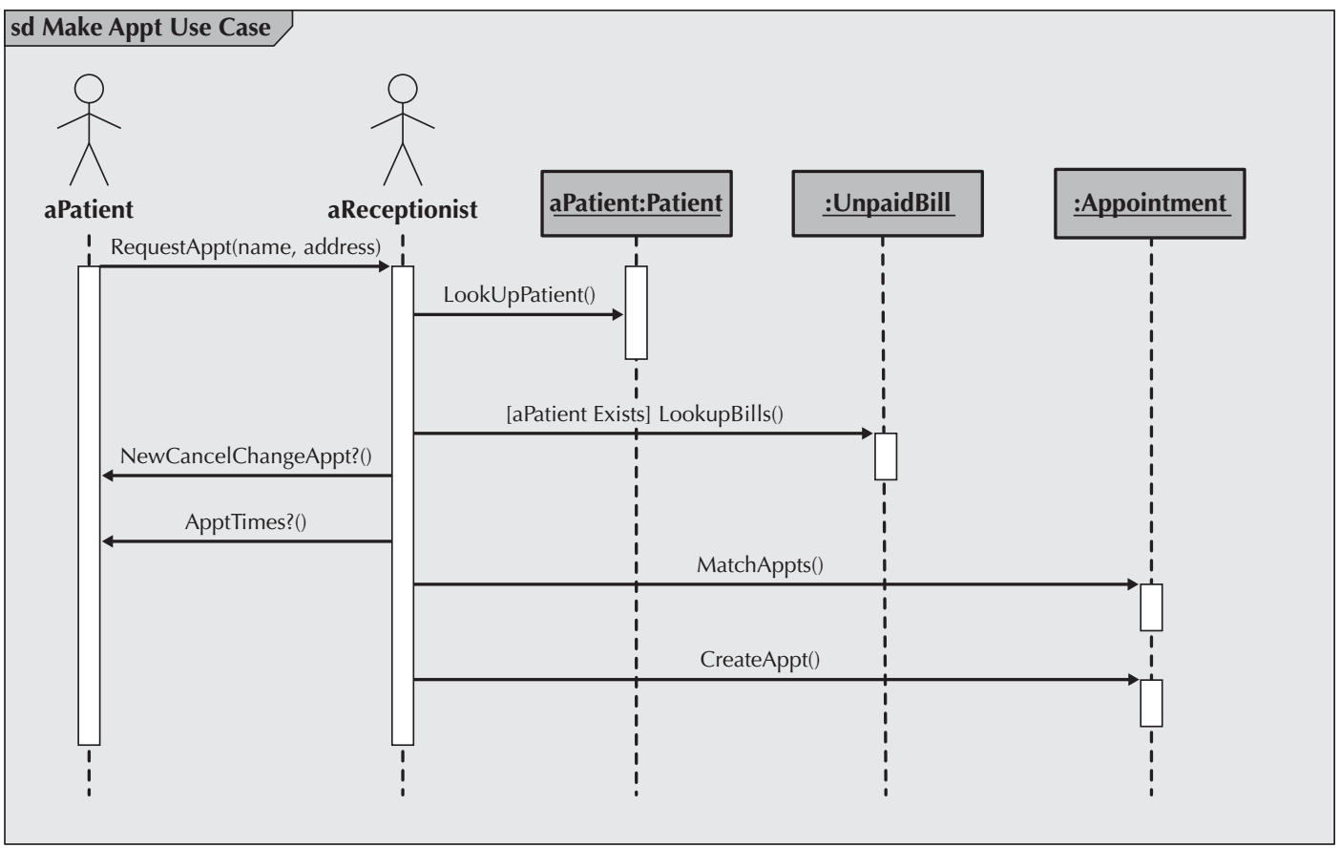
An instance sequence diagram

Slide 17
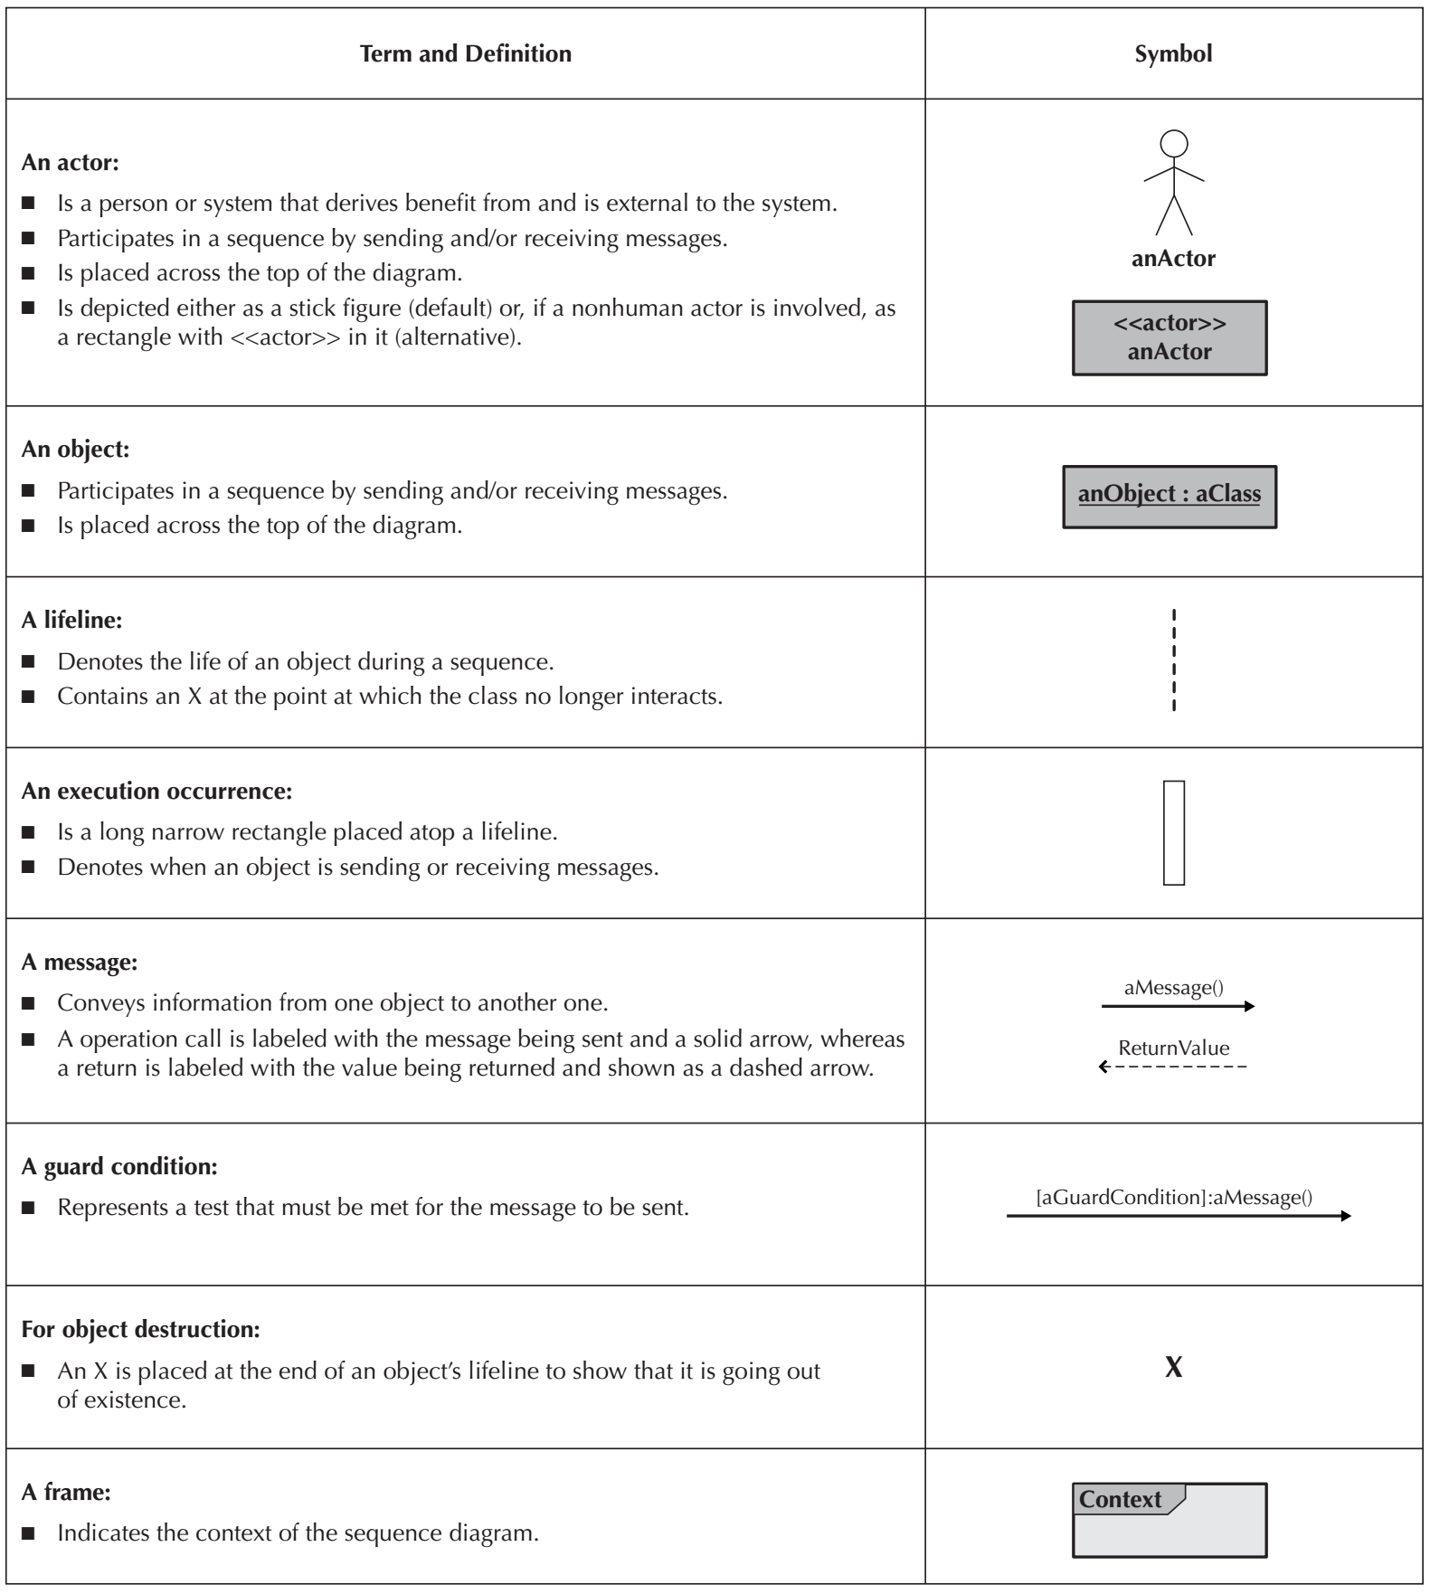
Elements of a Sequence Diagram

Slide 18
Elements of a sequence diagram(Cnt’d)

Slide 19
Elements of a sequence diagram(Cnt’d)
Actors and objects that participate in the sequence are placed across the top of the diagram using actor symbols from the use-case diagram. For each of the objects, the name of the class of which they are an instance is given after the object’s name.
A dotted line runs vertically below each actor and object to denote the lifeline of the actors and objects over time. Sometimes an object creates a temporary object; in this case, an X is placed at the end of the lifeline at the point where the object is destroyed. When objects continue to exist in the system after they are used in the sequence diagram, then the lifeline continues to the bottom of the diagram.
A thin rectangular box, called the execution occurrence, is overlaid onto the lifeline to show when the classes are sending and receiving messages.

Slide 20
Elements of a sequence diagram(Cnt’d)
A message is a communication between objects that conveys information with the expectation that activity will ensue.
Two types of messages: operation call and return. Operation call messages passed between objects are shown using solid lines connecting two objects with an arrow on the line showing which way the message is being passed. Argument values for the message are placed in parentheses next to the message’s name. The order of messages goes from the top to the bottom of the page, so messages located higher on the diagram represent messages that occur earlier on in the sequence, versus the lower messages that occur later. A return message is depicted as a dashed line with an arrow on the end of the line portraying the direction of the return. The information being returned is used to label the arrow.

Slide 21
Elements of a sequence diagram(Cnt’d)
At times a message is sent only if a condition is met. In those cases, the condition is placed between a set of brackets, []. The condition is placed in front of the message name.
An object can send a message to itself. This is known as self-delegation.

Slide 22
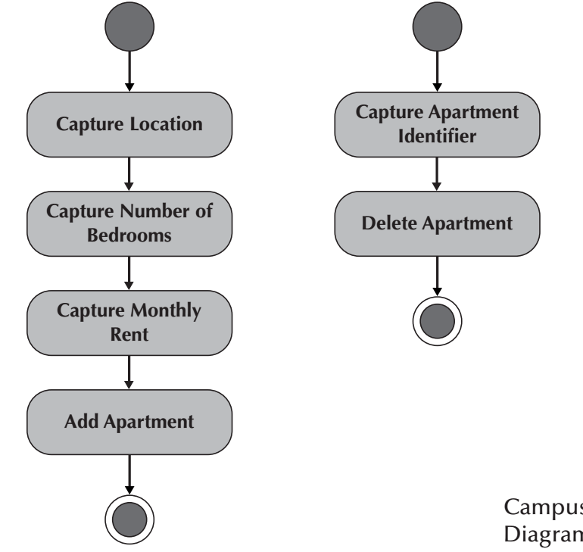
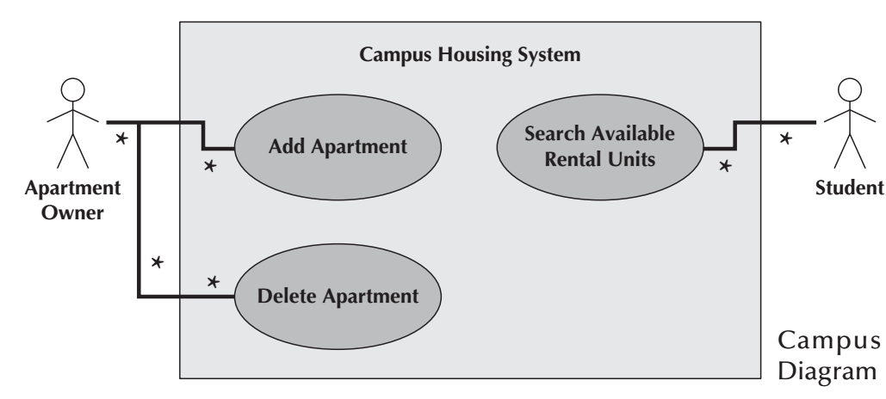
Campus Housing Service Functional Models

Slide 23
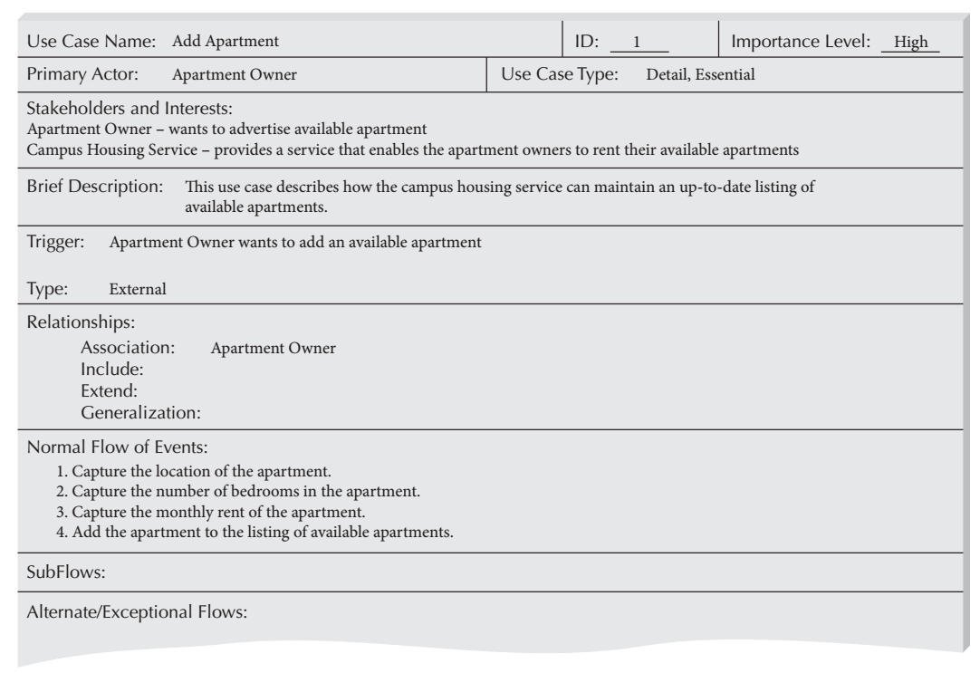
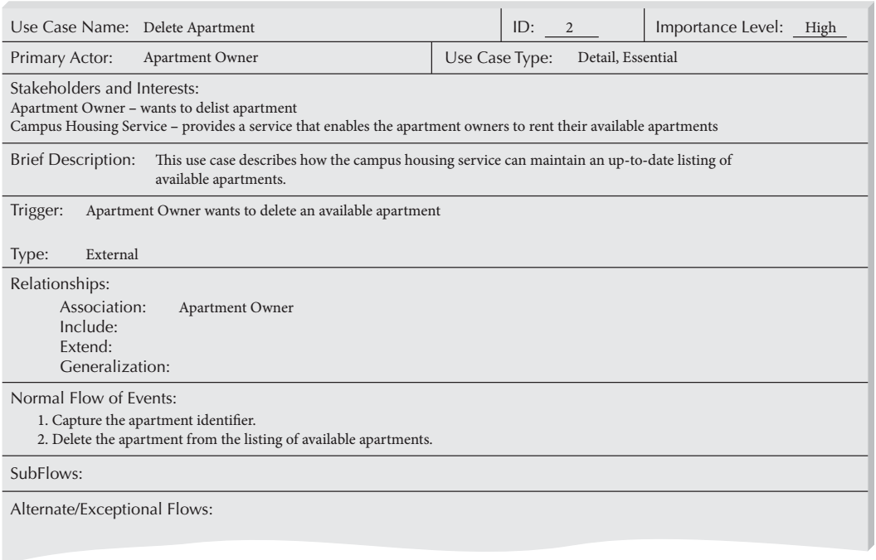
Campus Housing Service Functional Models(Cnt’d)

Slide 24
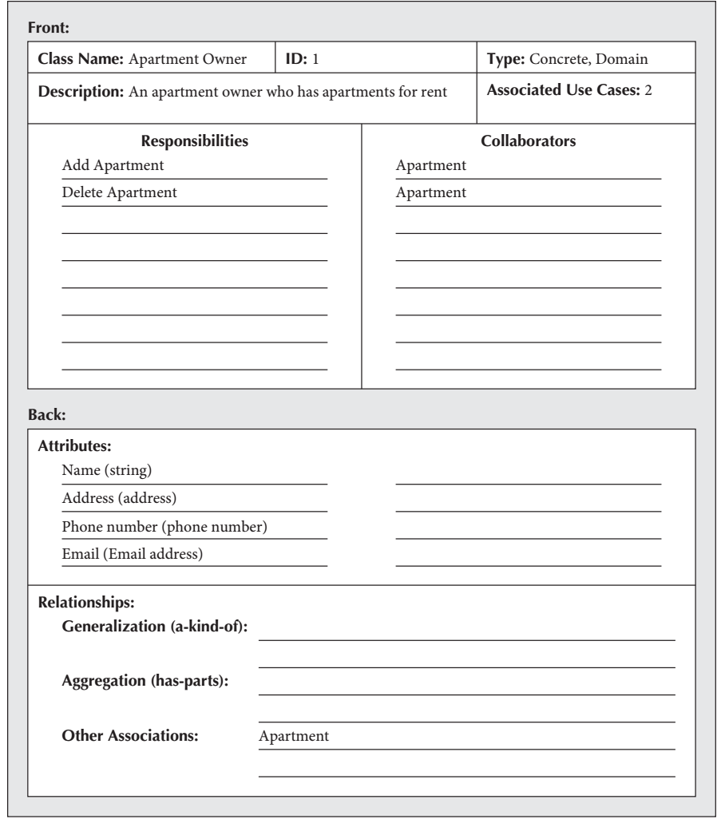
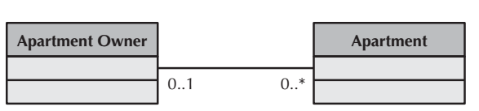
Campus Housing Service structural Models

Slide 25
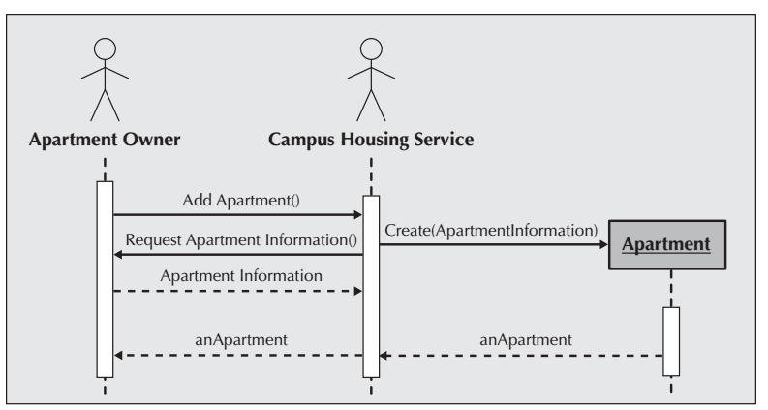
Sequence Diagram for the Add Apartment Use Case

Slide 26
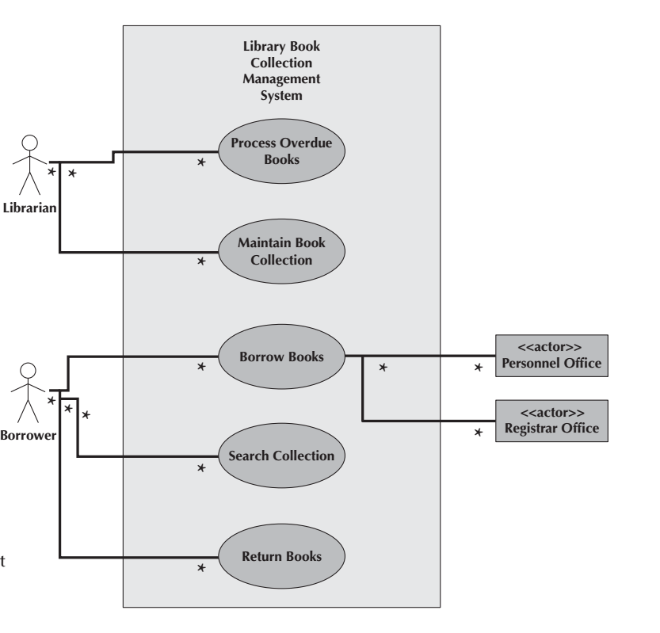

Slide 27
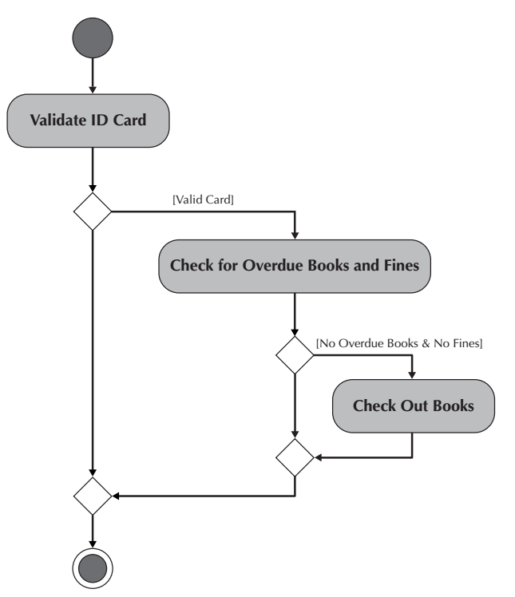

Slide 28
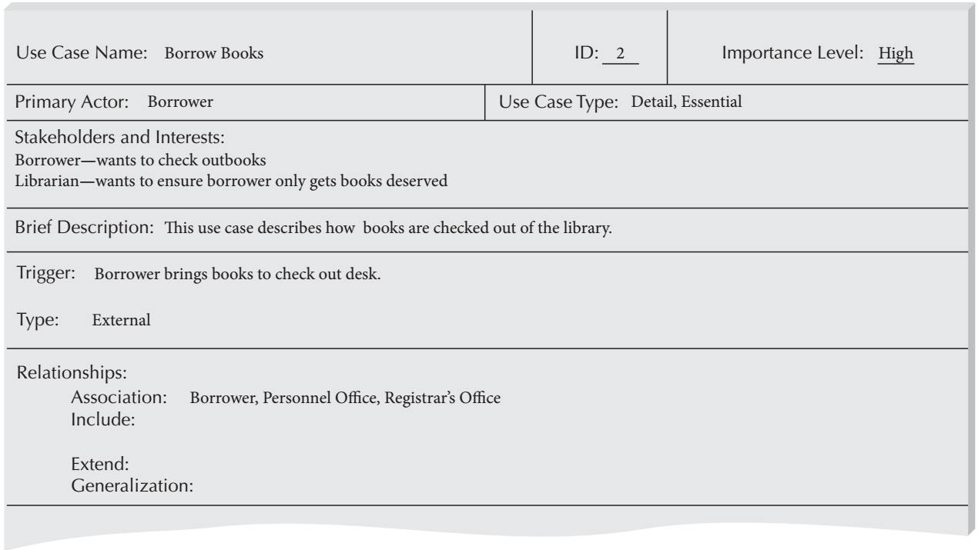
Overview Description for the Borrow Books Use Case

Slide 29
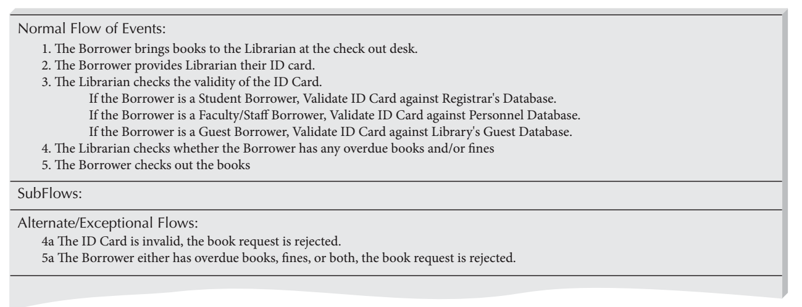
Flow Descriptions for the Borrow Books Use Case

Slide 30
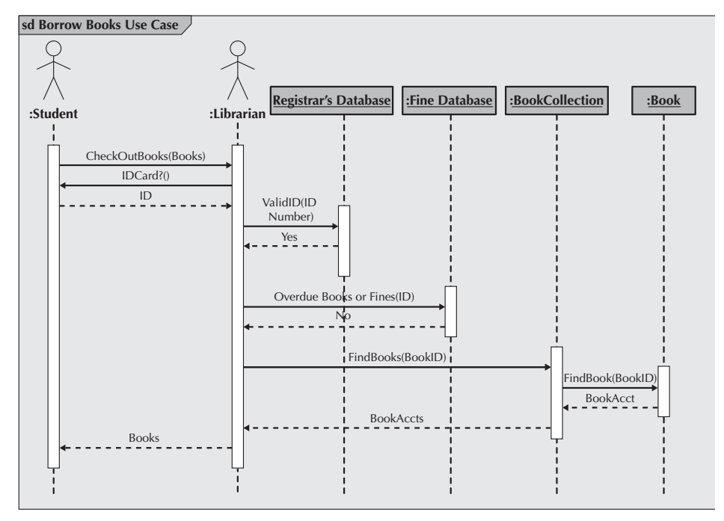
Sequence Diagram of the Borrow Books Use Case for Students with a Valid ID and No Overdue Books or Fines

Slide 31
Reference
Dennis, Wixon, Tegarden, “System Analysis and Design, An Object Oriented Approach with UML”, 5th Edition, 2015.

